Slide 1

>THE COCOMO MODEL >PROJECT DURATION AND STAFFING
PRAVEEN JUGAL -096
PRITHAM B G -099
RAHUL PATIL -105
RAJVIR MATTIKOP -106

Slide 2
PROJECT ESTIMATION TECHNIQUES
Estimation of various projects parameters is an important project planning activity .The different parameters of a project that need to be estimated includes
Project Size,
Effort required to complete the project,
Project Duration and
Cost
Accurate estimation of these parameters is important for resource planning and scheduling.Estimation Techniques can be classified as:
Empirical Estimation Techniques
Heuristic Estimation Techniques
Analytical Estimation Techniques
1

Slide 3
EMPHIRICAL ESTIMATION TECHNIQUES
Empirical estimation techniques are based on making an educated guess of the project parameters and common sense.
This technique is based on prior experience of development of similar products and projects.
an educated guess based on past experience.
Two popular empirical estimation techniques are:
Expert Judgment Technique
Delphi Cost Estimation
2

Slide 4
Expert Judgment Technique-
In this an expert makes an educated guess of the problem size after analyzing the problem thoroughly.
The expert estimates the cost of the different components of the system:
e.g. GUI,database module,communication module,billing module,etc.
Combines them to arrive at the overall estimate.
Delphi Cost Estimation
Is carried out by a team comprising of a group of experts and a coordinator.
The coordinator provides each estimator with a copy of the SRS document and a form for recording his cost estimate.
Estimators complete their individual estimates anonymously and submit to the coordinator.
3

Slide 5
Heuristic Techniques:
In Heuristic Techniques the relationship that exist among the different project parameters can modeled using suitable mathematical expressions.
Once the independent parameters are known,the dependent parameters can be easily determined by substituting the values of the independent parameters in the corresponding mathematical expressions.
assume that the characteristics to be estimated can be expressed in terms of some mathematical expression.
Can be classified as Single variable and multivariable models.
4

Slide 6
COCOMO(CONSTRUCTIVE COST MODEL)
Was first proposed by Dr. Barry Boehm in 1981.
Is a heuristic estimation technique- this technique assumes that relationship among different parameters can be modeled using some mathematical expression.
This approach implies that size is primary factor for cost,other factors have lesser effect.
"constructive"implies that the complexity.
COCOMO prescribes a three stage process for project estimation.
An initial estimate is obtained,and over next two stages the initial estimate is refined to arrive at a more accurate estimate.
projects used in this model have following attributes:
1. ranging in size from 2,000 to 100,000 lines of code
2. programming languages ranging from assembly to PL/I.
3. These projects were based on the waterfall model of software
Boehm stated that any software development project can be classified into three categories:
6

Slide 7
1.Organic:
If the project deals with developing a well understood application program.
The size of development is reasonably small and experienced.
The team members are experienced in developing similar kind of projects.
2. Semidetached:
If the development team consists of a combination of both experienced and inexperienced staff.
Team members have limited experience about some aspects but are totally unfamiliar with some aspects of the system being developed.
Mixed Experience.
3.Embedded:
If the software being developed is strongly coupled to complex hardware.
Software projects that must be developed within a set of tight software,hardware and operational constraints.
7

Slide 8
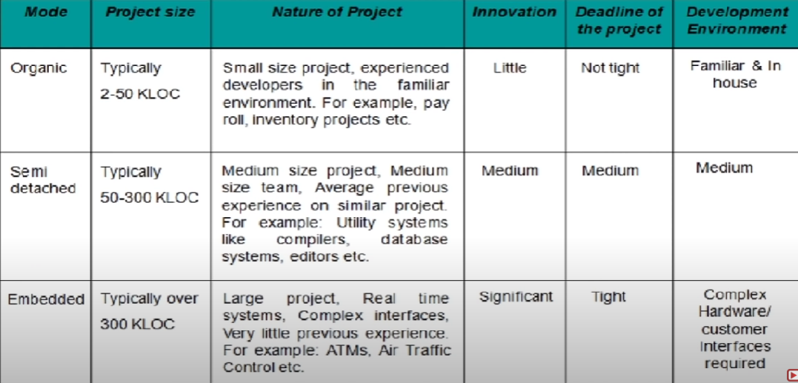
8

Slide 9
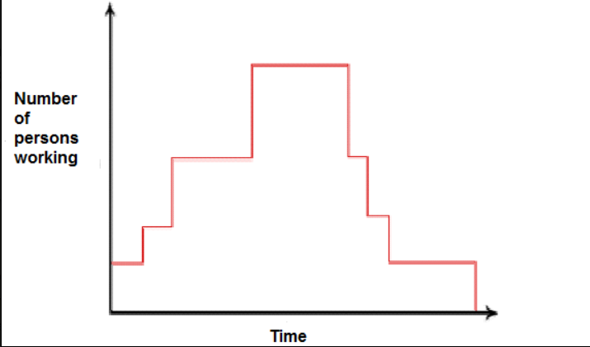
PERSON MONTH (PM)
The effort estimation is expressed in units of person months(PM).
An effort of 100 PM does not imply that 100 persons should work for1month nor does it imply that1 person should be employed for 100 months,but it denotes the area under the person-month curve.
It is the area under the person-month plot.
Person month is a measurement unit for effort in software engineering.1person month means effort put by a person in one month ,But 100 person does not mean,work effort put by 100 person in one month or 1person in 100 months .As requirement of staff varies time to time in the development so there is not constant no of people is there to work .It is calculated from the graph(calculate area under time axis)between no of people working and time(in month).
9

Slide 10
FIRST VERSION : COCOMO 81
The model parameters are derived from fitting a regression formula using data from 61 historical projects.
Estimates the total effort in terms of "person-month“ of the technical project itself.
Development time is estimated in terms of "kilo lines of source code"(KLSC).
According to Boehm,software cost estimation should be done through three stages:
1. Basic COCOMO
2. Intermediate COCOMO
3. Complete COCOMO
10

Slide 11

BASIC COCOMO MODEL
Basic COCOMO model computes software development effort,time and cost as a function of program size.Program size is expressed in estimated thousands of source lines of code(SLOC,KLOC).
Where,
KLOC is the estimated number of delivered lines(expressed in thousands)of code for project,estimated size of software product.
The coefficients a1,a2,b1 and b2 are constants for each category of software products.
Tdev is the estimated time to develop the software ,in months.
Effort is the total efforts required to develop the software product, expressed in Person Months(PM)
11

Slide 12
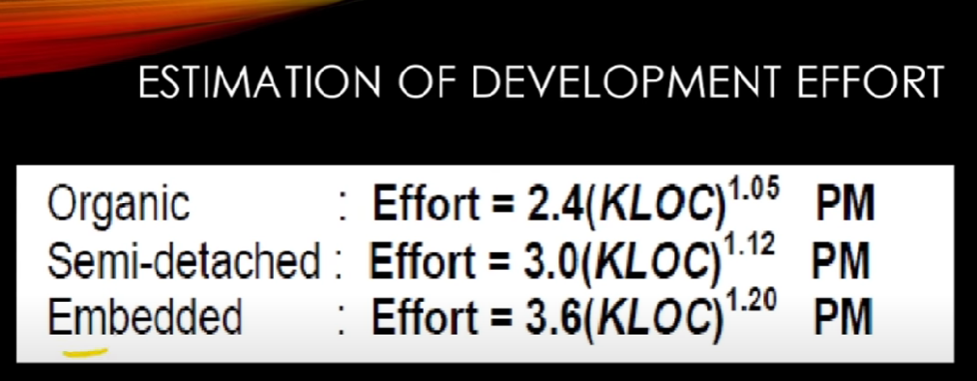
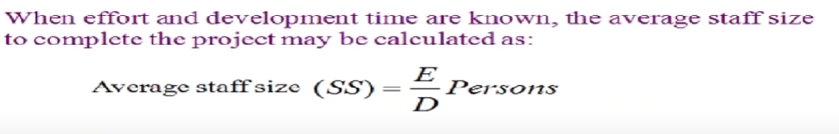
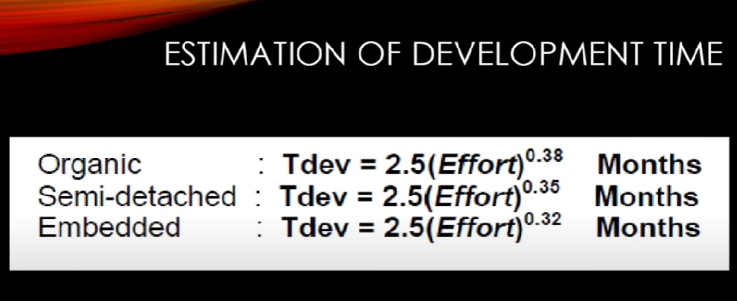
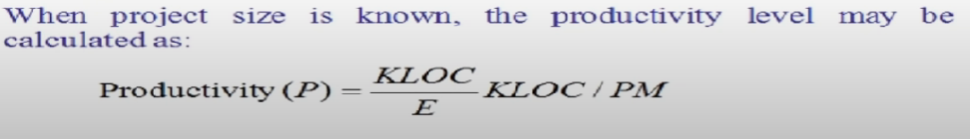
12

Slide 13
Example:
Consider a software project using semi-detached mode with 30,000 lines of code .We will obtain estimation for this project as follows:
(1)Effort estimation E=a1(KLOC)pow(a2)person-months
E=3.0(30)Exp(1.12)where lines of code=30000=30 KLOC
E=135 person-month
(2)Duration estimation D=b1(E)pow(b2)months=2.5(135)Exp(0.35)
D=14 months
(3)Person estimation N=E/D
135/14 N = 10 persons approx.
13

Slide 14
INTERMEDIATE COCOMO MODEL
Intermediate COCOMO computes software development effort as function of program size and a set of"cost drivers"that include subjective assessment of product ,hardware ,personnel and project attributes.
This model uses a set of 15 cost drivers ,these cost drivers are multiplied with the initial cost and effort estimates to scale the estimates up and down.
This extension considers a set of "cost drivers", each with a number of subsidiary attributes:
Product attributes
Required software reliability
Size of application database
Complexity of the product
14

Slide 15
Hardware attributes
Run-time performance constraints
Memory constraints
Volatility of the virtual machine environment
Required turnabout time
Personnel attributes
Analyst capability
Software engineering capability
Applications experience
Virtual machine experience
Programming language experience
Project attributes
Use of software tools
Application of software engineering methods
15

Slide 16

Each of 15 attribute receives a rating on a six point scale that ranges from “very low ” to “extra high”(in importance or value).
Formula now takes the form
Where
E:Effort applied in terms of person-mpnths
KLOC:Kilo lines of code for the project
EAF: It is the effort adjustment factor
16

Slide 17
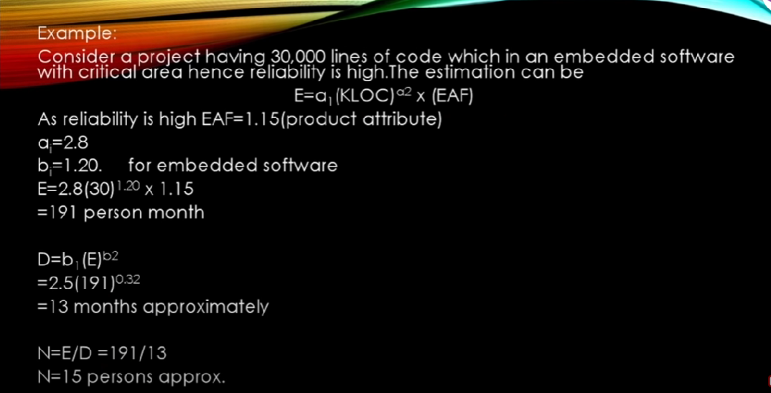

Slide 18
SHORTCOMING OF BASIC AND INTERMEDIATE COCOMO MODELS
BOTH MODELS
Consider a software product as single homogeneous entity
However ,most large systems are made up of several smaller subsystems
Some sub-systems may be considered as organic type ,some may be considered emedded etc
For some the reliability requirements may be high and so,on
SO ,complete COCOMO was proposed to overcome these limitations of basic and intermediate COCOMO

Slide 19
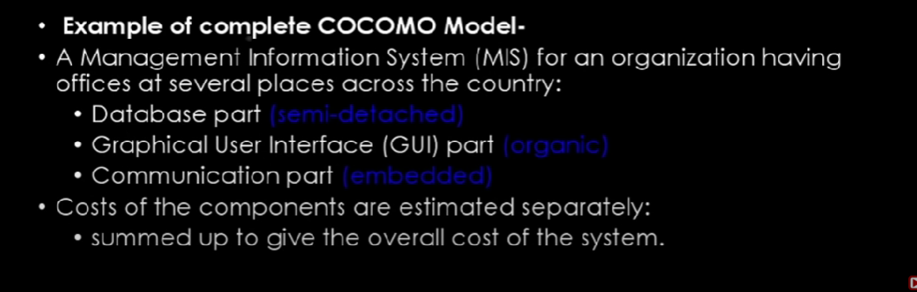
COMPLETE COCOMO MODEL

Slide 20
PROJECT DURATION
Duration is the total time that it takes to complete a project measured in work days, hours or weeks.
The duration depends on the availability and capacity of resources.
Effort is the number of people hours needed to complete a task, i.e. it’s the actual time that is spent on working on the project..

Slide 21
Why is it important to estimate project duration?
Project management is a game of precision. If you cannot estimate project duration, you won’t know how long your overall project will take or when you will reach certain stages or milestones.
This inability to estimate project duration can lead to multiple problems, including:
Not having resources
Not ordering
Upset customers
Inefficient employees

Slide 22
How is project duration calculated?
You can either estimate project duration by Two Methods ::
Top-down approaches
Bottom-up
You can also combine the two approaches to arrive at a duration somewhere in the middle.

Slide 23
PROJECT STAFFING
Staffing management plan and Resource management plans are important part of project resource management.
Planning for resources, acquiring resources, developing team and managing team are the important activities to be carried out as part of project resource management.
A staffing management plan contains a plan for addressing all the aspects of man power and will include Different Informations.

Slide 24
CONCLUSION
Staffing is the most important part of project management.
Hence it is extremely important to be very precise in planning and acquiring the right staff at the right time for the right duration.
It is also important to keep the staff members motivated and ensure their safety and well- being.

Slide 25


